Slide 1
Artificial Intelligence
3rd year, 1st semester
State based models for decision problems
Week 2: models and uninformed search strategies
“Intelligence is what you use when you don't know what to do” Jean Piaget

Slide 2
We aim to develop rational AI systems:
we define a problem and goals (instances)
the AI reaches the goals (solves the instances)
the AI outputs the result (unexplainable AI) or the solution (explainable AI)

Slide 3

First approach: state-based models
in what way should I change the
current state of the problem in order
to get closer or reach the goal?
compute a solution (algorithm
- sequence of steps) starting from an
initial state and ending in the goal state
mostly covered by search strategies,
reasoning systems, AI for games

Slide 4
Solving problems
Problem: We have two numbers, A and B. Which is larger?
Instance: A=?, B=?
A solution should produce the correct answer for all possible instances

Slide 5
What’s the Problem with problems?
P = set of problems that can be solved/checked in Polynomial time by a deterministic TM.
NP = set of problems that can be solved in Polynomial time by a non-deterministic TM. Validating a NP solution is a P problem.
NP-complete = subset of NP with the property that any problem in NP can be reduced to a NP-complete problem in polynomial time.
NP-hard = set of problems with the property that any problem in NP can be reduced to a NP-hard problem in polynomial time.
P=NP ?

Slide 6
Let the computer solve our problems! Or not...
Solvable NP-hard problems: QSAT: is a logical proposition using quantified (existential ∃ or universal ∀) variables satisfiable?
Undecideable NP-hard problems: Turing Halting problem: given an algorithm and an input, determine whether the algorithm execution for that input will eventually halt.
The rest can be solved by a computer.

Slide 7
Stop looking for solutions!
Don’t think about solutions, think about problems.
Solving problems requires effort, describing problems requires intelligence.
“If I had only one hour to save the world, I would spend fifty-five minutes defining the problem, and only five minutes finding the solution.” A.Einstein

Slide 8
Let’s find a NP-complete problem and help a computer to solve it
Problem: finding a path in a graph
Describing a model - reducing a problem
describe a state
identify special states and the problem space
describe the transitions and validate them
specify a search strategy

Slide 9
Problem: finding a path in a graph
Finding a path in a graph is NP-complete, however it can easily be scaled up to NP-hard by many slight reformulations, such as:
Finding a path if the graph has cycles
Finding the longest path
Graph coloring
Finding cliques
This means that you can also solve NP-hard problems using the same method by adapting the requirements.

Slide 10

Generalized Hanoi Towers
We have n towers with m distinct sized pieces placed on one of the towers. Considering that you can only move one piece at a time and that no piece can be placed on top of a smaller piece, find a sequence of movements that place all pieces on a different tower.

Slide 11

Choosing a representation for a state
State: all data required to continue looking for a solution
No ambiguity
Expressive enough to include all required data

Slide 12
Choosing a representation for a state
Compact enough to be easy to store and perform changes on it
A list of towers pieces are placed, in the order of piece size size
(3, 3, 3, 3, 3, 1, 1, 1, 2, 2)
Is this good enough?

Slide 13
Choosing a representation for a state
Compact enough to be easy to store and perform changes on it
A list of towers where pieces are placed, in the order of piece size, with the number of towers added at the beginning
(3, 3, 3, 3, 3, 3, 1, 1, 1, 2, 2)
(n, t₁, t₂,...,t_{m}), 1≤t_{i}≤n

Slide 14
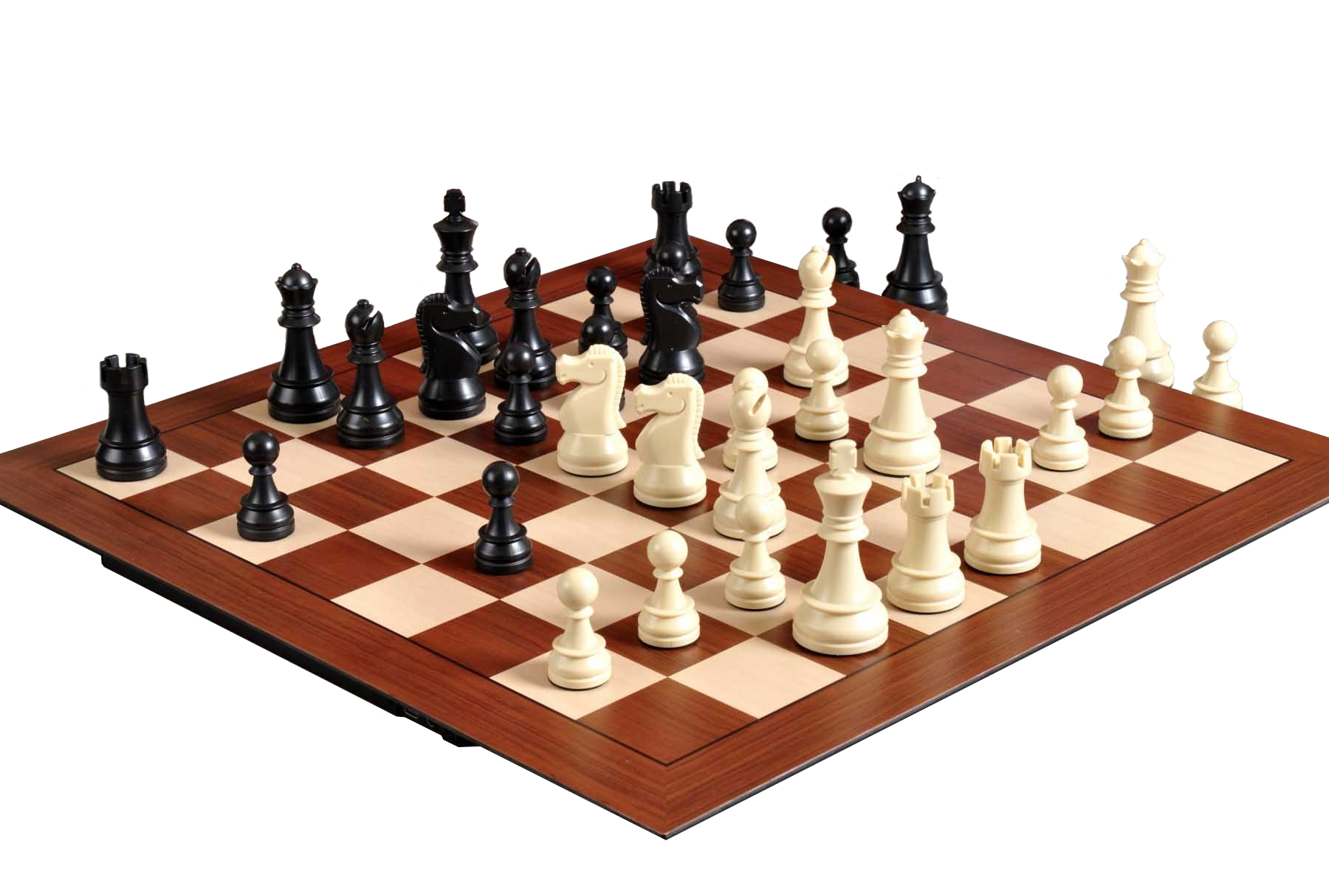

Choosing a representation for a state is the most important and difficult step
No ambiguity
Compact
Expressive
Includes all required data
There is no generally best representation

Slide 15
Special states
Initial state (3, 1, 1, 1, 1, 1, 1, 1, 1, 1, 1)
State Initialize (int n, int m)
{
Return (n, 1, 1, 1, …, 1);
}
m
There can be more than one initial state. There has to be at least one initial state.

Slide 16
Special states
Final state(s) (n, n, n, n, n, n, n, n, n, n, n)
Boolean IsFinal (State s)
{
If s = (k, k, k, …, k) then return true;
m+1
else return false;
}
There can be more than one final state. There has to be at least one final state.

Slide 17
Problem space: all possible states
Finite space (limited variability in chosen state representation and only valid states are included)
Final state
Initial state

Slide 18
What is the problem now?
How difficult is it to solve?
Problem space has m dimensions
How many states are within the space?
How can you move within the
problem space?
Simon’s Ant
Complexity of the solution is determined by the problem, NOT by the way in which you solve it
Final state
?
Initial state

Slide 19
Transitions
Only one possible way to change current state: move one piece to another tower.
(n, t₁₁, t₁₂,...,t_{1m}) → (n, t₂₁, t₂₂,...,t_{2m}), where t_{1i} = t_{2i} for all 1≤i≤m, except exactly one i = k
State Transition (State s, piece, tower)

Slide 20
Valid transitions
No smaller piece is placed atop piece k
No smaller piece ends up below piece k
t_{1i} ⧧ t_{1k} , for all 1≤i<k
t_{2i} ⧧ t_{2k} , for all 1≤i<k
Boolean Validate (State s, piece, tower)
Implement transitions and validation separately, it’s good practice!

Slide 21
Search strategy
Void strategy(State s)
{
While (!isFinal(s))
{
Choose piece, tower;
If (Validate (s, piece, tower))
s = Transition(s, piece, tower);
}
}

Slide 22
Search strategies
Uninformed - no distinction between states
Random
BFS and Uniform Cost
DFS and Iterative Deepening
Backtracking
Bidirectional
Informed - heuristics to help distinguish between states
Greedy best-first
Hillclimbing and Simulated Annealing
Beam
A* and IDA*

Slide 23
Breadth First Search and Uniform Cost
Visit states in the order of distance (number of transitions) from the initial state.
Explores all immediate neighbors (accessible states) until no more neighbors or final state found.
Has to memorise each generated state: very costly.
Might visit the same state multiple times.
Finds shortest path (optimum solution)
Uniform cost: if options have different costs, explore cheaper paths first

Slide 24
Depth First Search and Iterative Deepening Search
Visit one immediate neighbor of the current state until final state is found, return to previous unexplored neighbor if no more neighbours available for current state.
Has to memorise each generated state: very costly.
Might visit the same state multiple times.
Might not finish (if loops are present in the problem space)
IDS: Explore only up to an increasing depth (distance from initial state) - no more infinite paths

Slide 25
Random vs DFS
The same, if random remembers visited neighbours
Backtracking vs DFS
NOT the same
Backtracking sets an order for the neighbor states
How do you order states?
Backtracking doesn't need to memorize visited states!
Backtracking can avoid loops WITHOUT storing visited states
Backtracking can prune invalid branches earlier, if the order and selection of neighbours is optimal

Slide 26
Bidirectional Search
Starts exploring from both the initial and final state simultaneously
Has to memorise each generated state, but they should not be that many
Finds shortest path (optimum solution)
What are the reverse transitions?

Slide 27
Comparison
Complexity of the solution is given by the problem, NOT by the way in which you solve it
N = average number of accessible states
O = length of the optimum solution
A = length of the average solution
Criterion | BFS | DFS | IDS | Bidirectional | BKT | Random
ETC | N^{O} | N^{A} | N^{O} | N^{O} | N^{A} | N^{A}
Optimum | Yes | No | Yes | Yes | No | No
All | Yes | No | Yes | Yes | Yes | No

Slide 28
Additional references
Uninformed Search Algorithms
Stanford Programming Abstractions

